Slide 1
Reading the Bible
18
Dr. Rick Griffith • Jordan Evangelical Theological Seminary • BibleStudyDownloads.org

Slide 2
Observation
18
We must observe before we can interpret!

Slide 3
The Inductive Approach
20
 | Book (Synthetic)
Observe (What do I see?) | Passage or Detail (Analytical) | Interpret the Observations (What does it mean?)
 | Topic (Topical)

Slide 4
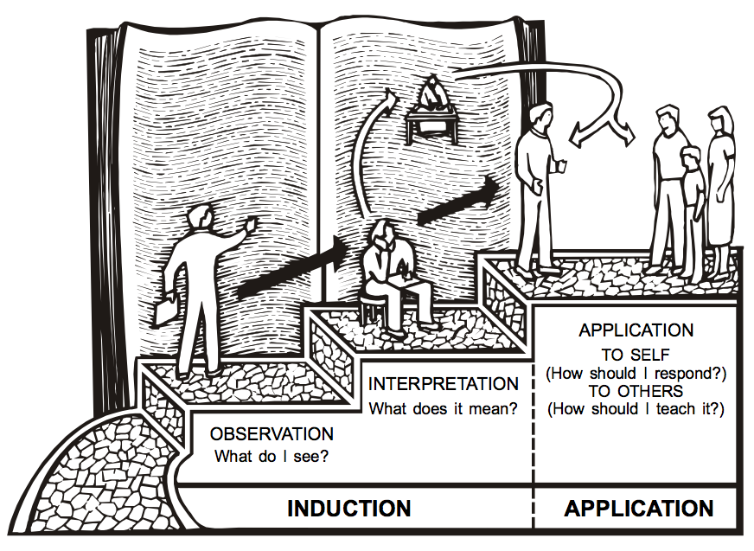
The 3-Step Process
20
APPLICATION
TO SELF
INTERPRETATION
(How should I respond?)
What does it mean?
TO OTHERS
OBSERVATION
(How should I teach it?)
What do I see?
INDUCTION
APPLICATION

Slide 5
Inductive Bible Study
20a
Complete the two exercises on page 43.

Slide 6
How many squares do you see below?
43
1 = 16

Slide 7
How many squares do you see below?
43
1 = 16
2 = 9

Slide 8
How many squares do you see below?
43
1 = 16
2 = 9
3 = 4

Slide 9
How many squares do you see below?
43
1 = 16
2 = 9
3 = 4
4 = 1
Total = 30

Slide 10
Can you draw four straight, connected lines without lifting your pen from the paper but go through each dot only once?
43

Slide 11
Inductive Bible Study
20a
Complete the two exercises on page 43.
What's the difference between deductive and inductive Bible study?
Why should we study the Bible inductively?
What is the goal of Bible study?

Slide 13
Bible Study link at BibleStudyDownloads.org
Get this presentation for free!
Notes:
Bible Study (bs)

